Slide 1
Unit 210: Understand how to communicate with others within building services engineering
Site management team

Slide 2

The construction of a building is a complex process that requires many professionals – ‘the construction team’ – to work together.
We need to have an understanding of the role and responsibility of the members of the construction team.

Slide 3
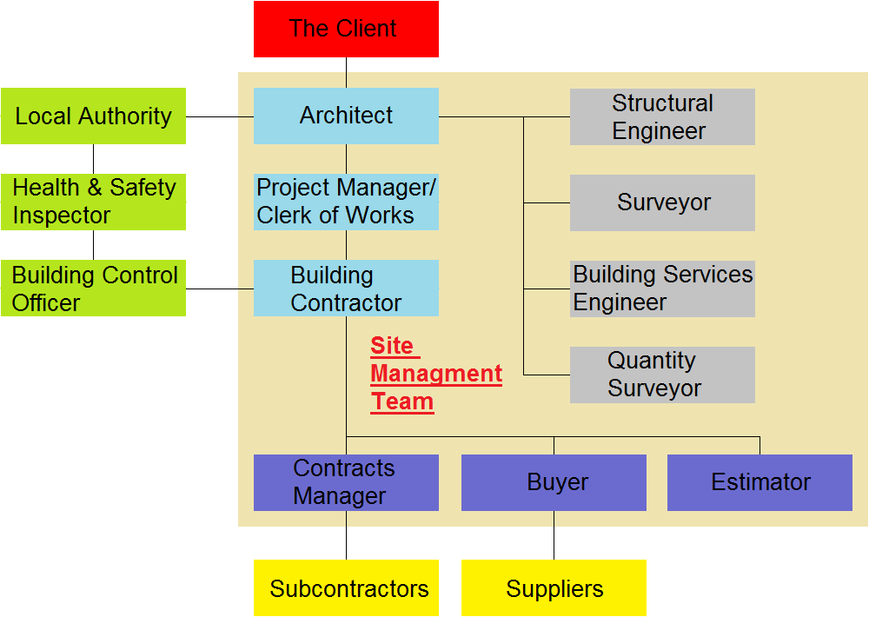
Site Management

Slide 4
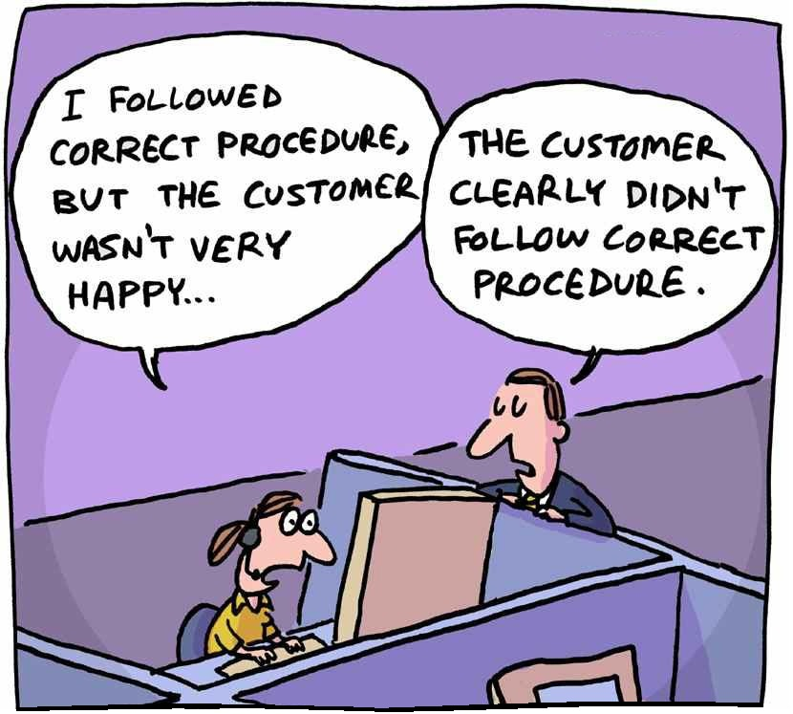
Site Management Team
The client
Probably the most important person, as they are the reason the project is going ahead.
The client will be an individual, company or organisation and they will employ contractors directly or indirectly.

Slide 5
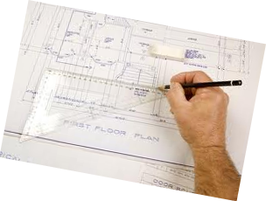
Site Management Team
The architect
The architect is the designer of the project and considered the leader of the management team.
They convert the clients’ ideas and requirements into a building design and working drawings.
They liaise regularly with the client at the early stages, and throughout the project.

Slide 6

Site Management Team
The clerk of works (project manager)
Generally appointed by the architect, the clerk of works acts as their representative on site.
They ensure that the building is constructed according to the drawings, as well as checking the standard of work and quality of materials.
They liaise regularly with the architect and the construction teams on site.
They can sign a variation order.

Slide 7
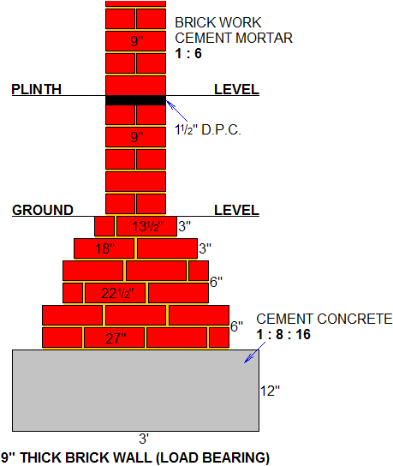
Site Management Team
The structural engineer
They work closely with the architect to find the most efficient method of construction.
They calculate loads, forces, and variances from wind and rain, looking at structural safety.
They are sometimes involved in insurance claims, repair work and alterations to properties.

Slide 8

Site Management Team
The surveyor
Sometimes known as the building surveyor, they have to position the building on the land and ensure that Building Regulations are followed throughout the process.
They will discuss problems on the way and try to resolve difficulties.
They will visit site regularly to ensure that the building process is being carried out correctly.

Slide 9
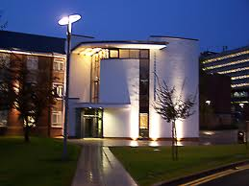
Site Management Team
The building services engineer
They design the internal services within the building, which will be cost effective, environmentally sensitive and with good maintenance access.
They will be responsible for: heating and ventilation, plumbing, electrical distribution, fire protection, lifts, escalators, acoustics, etc.

Slide 10
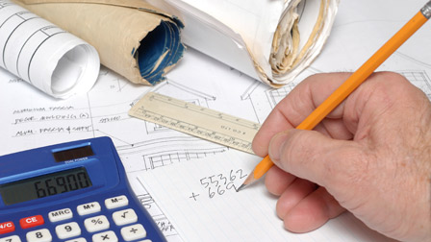
Site Management Team
The quantity surveyor
They suggest construction methods that are within the clients’ budget.
They also calculate the amount of labour and materials required to complete the project. These details are then collated in the Bill of Quantities which is used by contractors to produce an estimate/quotation.
The quantity surveyor will visit site to measure work carried out to produce interim payments and final accounts.

Slide 11
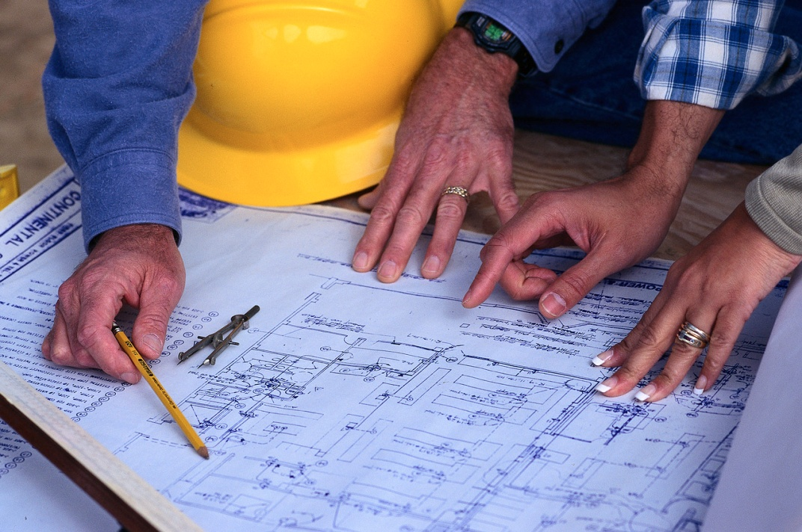
Site Management Team
The building contractor
The contractor will enter a contract with the client to carry out the work in accordance with the drawings, Bill of Quantities and specification.
Each contractor will tender for jobs.
They will need to employ specialists within the trade to undertake key roles.

Slide 12
Site Management Team
Contracts manager
Construction contracts managers oversee projects from the start through to completion, ensuring that work is completed on time and within its budget.
At all times, and for as long as the contract lasts, they are the first point of contact for members of the public, clients, site managers and sub-contractors.
Health and safety issues are a top priority in this role, as is managing client expectations.

Slide 13

Site Management Team
Contracts manager (continued)
The role includes negotiating sub-contract orders and monitoring sub-contractors, planning critical dates or organising labour.
They would also be responsible for agreeing extra work to be done on a contract, helping to resolve any disputes which come up and identifying areas for improvement in your company’s contracting processes.

Slide 14

Site Management Team
The buyer
They will source all the materials needed to complete a project, by obtaining quotations from suppliers for materials, with delivery times and quality assurance.

Slide 15
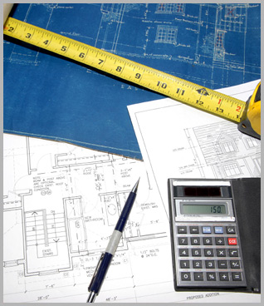
Site Management Team
The estimator
The estimator will break down the Bill of Quantities into unit parts which represent the amount it will cost a contractor to complete each stage.
To this they will add company overheads and profit margins.

Slide 16
Unit 210: Understand how to communicate with others within building services engineering
The End

